Slide 1
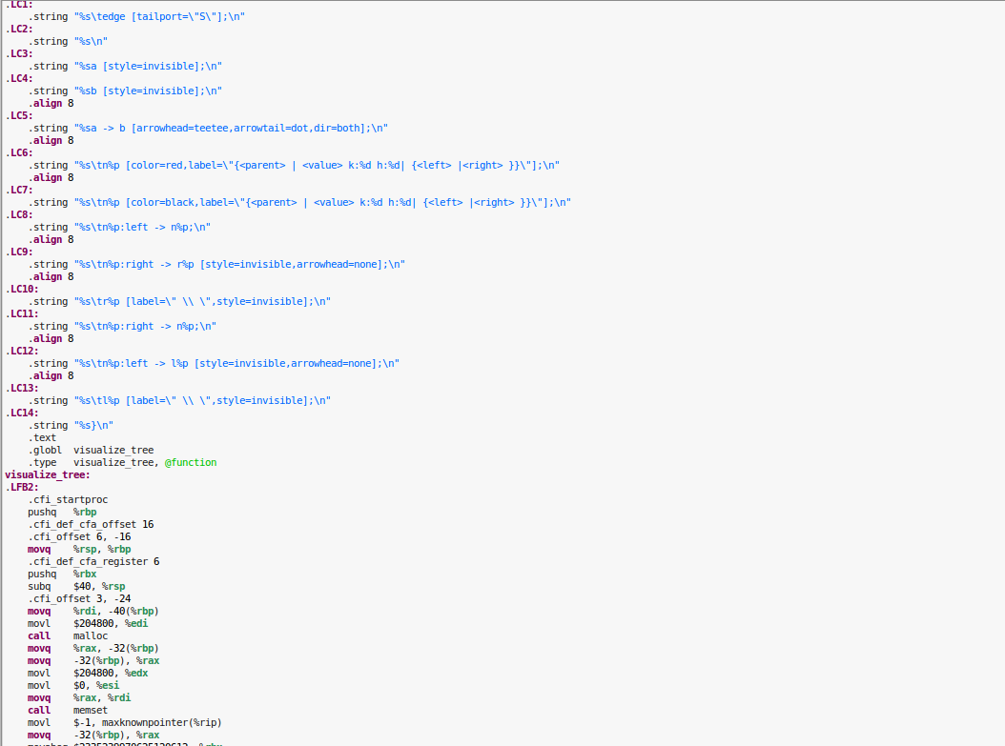
\English

Slide 2
basics
- syntax consists of programmatically-defined operators
- highly functional
- compiled to x86_64 NASM
- strongly, statically typed

Slide 3
syntax
If your car's engine is broken, print “My car broke down!”.
if my car's engine is broken, print “My car broke down!”

Slide 4
programmatically-defined syntax
- readability with inlaid words and punctuation
- high-order functionality augments this readability
- adds structure

Slide 5
programmatically-defined syntax
define {modifiers} <{type}> {declaration}: {body};
- {type} is the return type of the operator; this may become optional in later versions.
- {declaration} is a context-dependent grammatical description of the operator's syntax
- {body} is a series of operators that represents the operations this operator will execute when called.

Slide 6
programmatically-defined syntax
<int Num1> - <int Num2>
5 - 7
(<int Numbers>, )+ and <int Last Num>
15, 3, 7, and 7
/”(.+?)”/
/”\w[\w.]*@\w+\.\w{2,4}”/

Slide 7
highly functional
- high order functionality
- partially applicable functionality
- no void returns
- heavily optimizable with finalization and other techniques

Slide 8
highly functional
<bit Left> or <op()=>bit Right>
List = null or List contains 3
<op(@)=>bit Op>'s index in <list of @s List>
(<regex> matches “3F”)'s index in /”.”/, /”\w”/, and /”\w+”/

Slide 9
syntax
If my car's engine is broken, print “My car broke down!”.
if <bit Condition>, <op=>@ Op>

Slide 10
syntax
If my car's engine is broken, print “My car broke down!”.
if <bit Condition>, <op=>@ Op>
my car

Slide 11
syntax
If my car's engine is broken, print “My car broke down!”.
if <bit Condition>, <op=>@ Op>
my car
<car Car>'s engine

Slide 12
syntax
If my car's engine is broken, print “My car broke down!”.
if <bit Condition>, <op=>@ Op>
my car
<car Car>'s engine
<engine Engine> is broken

Slide 13
syntax
If my car's engine is broken, print “My car broke down!”.
if <bit Condition>, <op=>@ Op>
my car
<car Car>'s engine
<engine Engine> is broken
print <string Message>

Slide 14
syntax
If my car's engine is broken, print “My car broke down!”.
if <bit Condition>, <op=>@ Op>
my car
<car Car>'s engine
<engine Engine> is broken
print <string Message>
string “.*”

Slide 15
compiled to NASM
asm
- program product is more efficient
- NASM assembler is freely licensed
- Assembly does not restrict the language's abilities

Slide 16
compiled to NASM
asm cmp Cond, 0
asm jne if_end
run True Branch
asm if_end:

Slide 17
functional syntax
run {ops} with {arguments}
- {ops} is a list of operators to run.
- {arguments} is a list of arguments to pass.
run {ops} with {arguments} using {contextual ops}
- {ops} is a list of “incomplete” operators.
- {arguments} is a list of arguments to pass to ops.
- {contextual ops} is a list of context-specific operators that can be used to parse ops.

Slide 18
functional syntax
while <op()=>bit Condition> <op() Body>
asm while_start:
op Break := define break:
asm jmp while_end;
if (run Condition) = false, run Break
run Body using Condition and Break
asm jmp while_start
asm while_end:

Slide 19
strongly, statically typed

Slide 20
strongly typed
- increases understanding
- decreases ambiguity
- allows reuse of syntaxes
<string> <string S1> \+ <string S2>
<int> <int Num1> \+ <int Num2>
Number + 3

Slide 21
statically typed
- increases efficiency
- increases understandability
- reveals more errors at compile time
int Value := 1
[…]
Value := “Hello, world!”
[…]
print Value + 3

Slide 22
modifiers, implicit conversions, and libraries

Slide 23
conversion
- reduces code length
- increases code readability
- reduces code redundancy
print <string Message>
print “Hello, world!”
print 4
print Messages
print Cars

Slide 24
modifiers
- wrap around operators
- Python function decorators + Java/C++ visibility modifiers + Java annotations
- lost at compile time with types
define <modifier> debugged <op>:
print “starting ” + Op + “...”
run Op
print “completed ” + Op;

Slide 25
templates
- helps model A.P.I.s
- allows duck typing of types
- Java abstract classing + interfaces
- template-full types allow classification of pre-existing types without modification
define <type> comparable to <type Type>:
a new type with
template <bit> <this> > <Type>:;

Slide 26
error handling
- clarifies error
- clarifies where errors can occur
- efficient at runtime
- no “null” ambiguity
<binary tree?> <binary tree Tree>'s left

Slide 27
units
- clarifies values
- no hideous syntax
- no bad documentation concern
- make your science teachers happy
<distance> <number Value>km
<number> <distance Dist> in inches

Slide 28
libraries
- allows use of existing programs
- can have all the same optimizations and abilities as \English
- C-like function/method definition:
<type Return Type>
(\w+)\((<type Arg Types> \w+){“, ”}\)
\{ <op Ops>*\}

Slide 29
the compiler

Slide 30
parsing
- parsed as a C.D.G.
- operators organized into a trie-like data structure
- when new operators are defined, they are added to the data structure
- scope is defined by file or the run…using operator

Slide 31
requirements
- create \English compiler
- compiles any given \English code
- handles final and CoW optimizations
- create \English stdlib
- numbers, strings, and other basics
- create C lib
- compiles C source code with \English or alone

